Slide 1


Slide 2
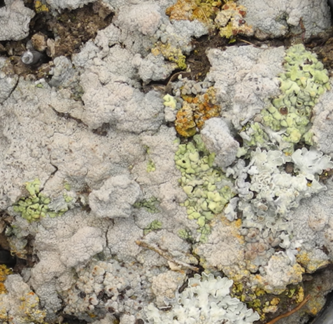

Slide 3
I hope I can learn (at least abit) the language of R, i would also need basic introduction on how to handle input data for R, how to generate heat-maps or data anylsis (right now I'm using PRISM for analysis).
I look forward to learning how to write specific codes for my data to get desired plots or analysis
Since R is completely new to me, I want to build a well established foundation for using R in order to further expand on it on my own in the future.
Ways to present multiple variables together in graphs or tables.
I just want to learn R and expand my knowledge in scientifc data analysis
Develop approaches to analyze survey data beyond descriptive statistis, such as by identifying the relations between data sets through factor analysis.
bulk RNAseq analysis
After months of trying (and often failing) to learn using R on my own, it'd be dreamy to gain a solid foundation in a structured (and painless...) manner, and perhaps extend my horizon of visualization beyond line plots.

Slide 4
What are the molecular basis of learning and memory in the brain?
Is this newly developped sample preparation technique suitable for use in clinical diagnostics?
Biophysics
How do neurons connect to their partners?
Behavioral economics
To study the biofilm formation process in flow by analyzing the fluorescent images
Biochemistry
Environmental ecology
Department of Economics and Government of Agriculture, Food and Natural Resources
Structure and Function study of the Glycogen Debranching Enzyme
The impact of tripartite interactions among host immunity, microbiota, and pathogens on pathogen virulence evolution
How can biochemical markers and comparative methods contribute to the monitoring of ash dieback in Germany?
The effect of community diversity on bacterial spatial patterns in the phyllosphere

Slide 5
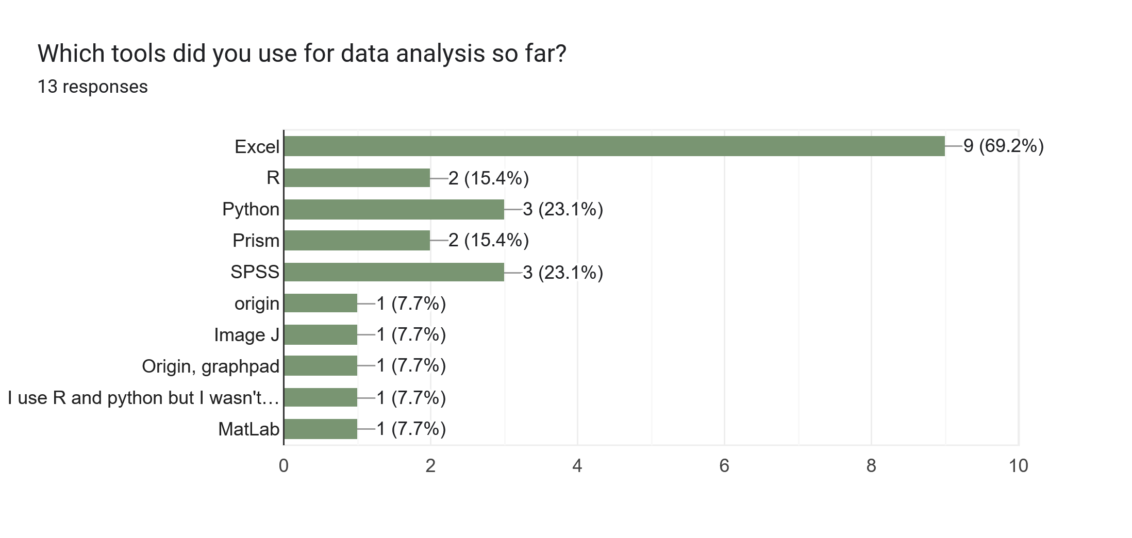

Slide 6
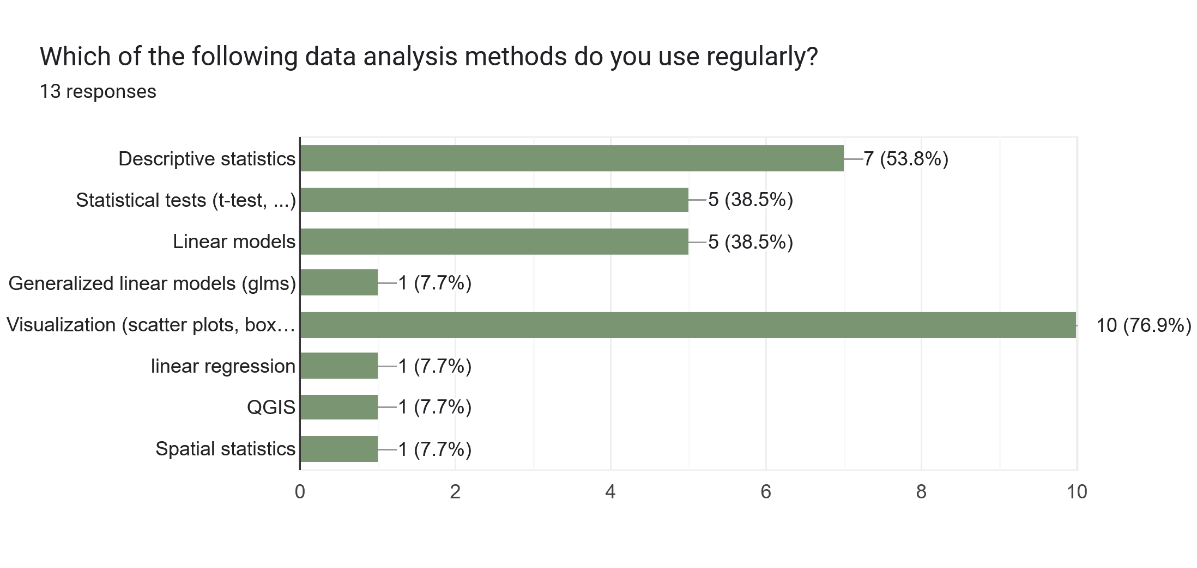

Slide 7
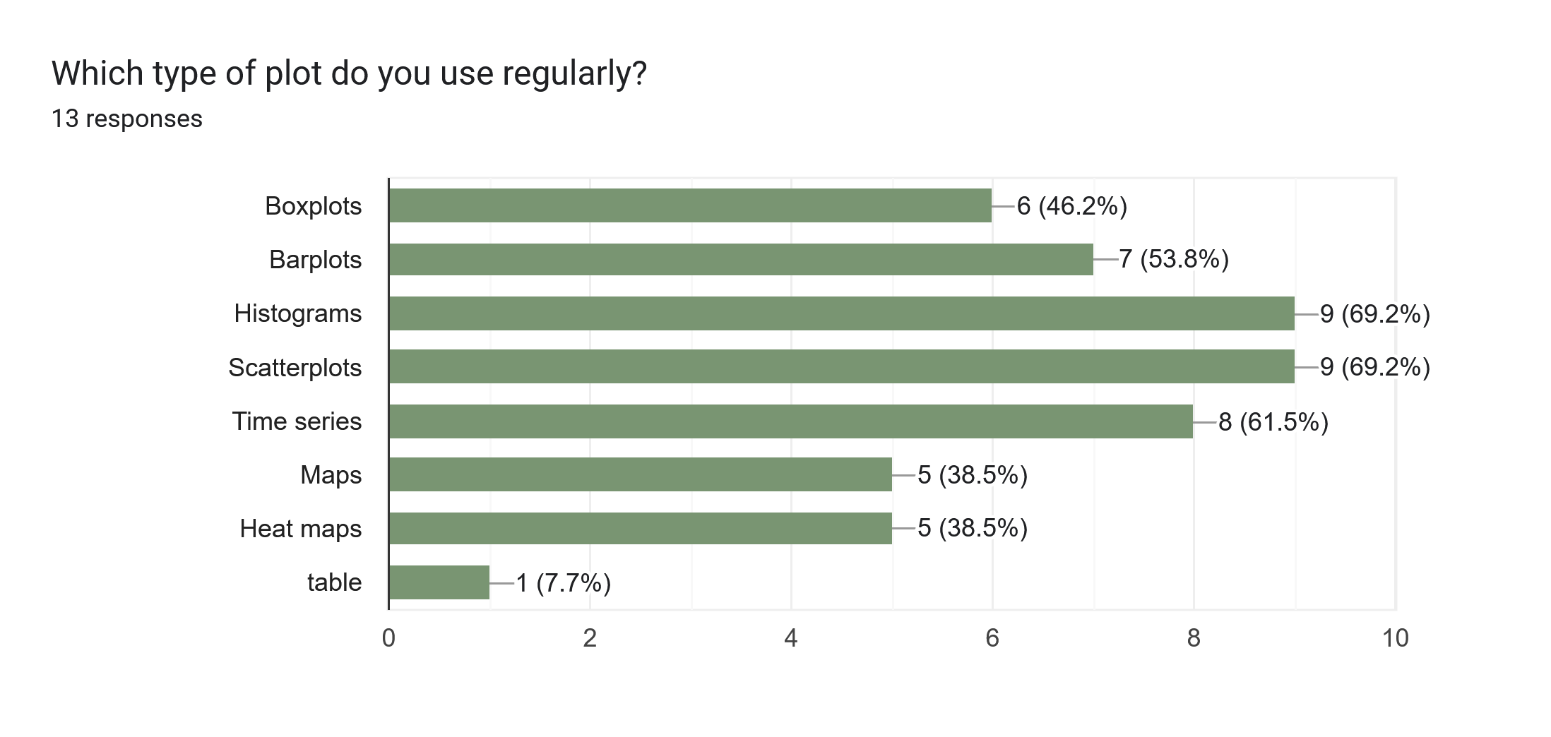

Slide 8
Visualize
R basics
Import
Tidy
Transform
Communicate
Stats
Data analysis workflow

Slide 9
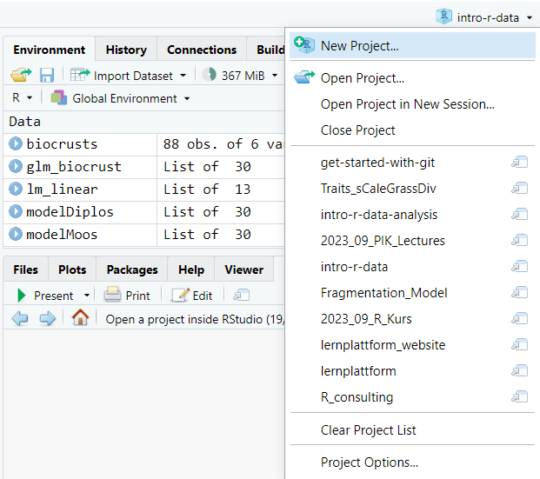

Slide 10
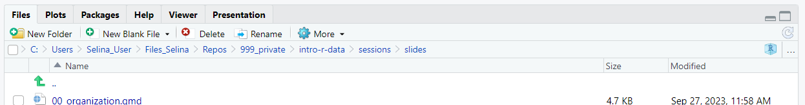
Project path
Go to project root
Open project in file explorer
Navigate one level up

Slide 11
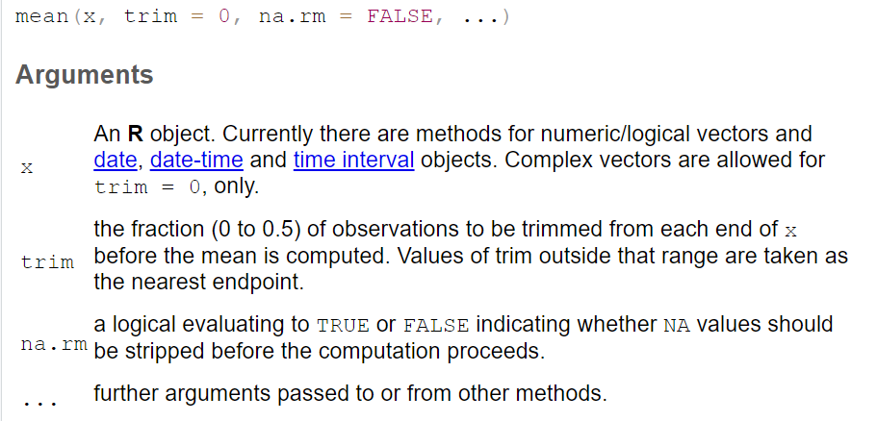

Slide 12
Function name
Input
Processing
Output
Side effects

Slide 13
mean
c(1, 5, 6)
Add values and divide by the length of the vector
4

Slide 14
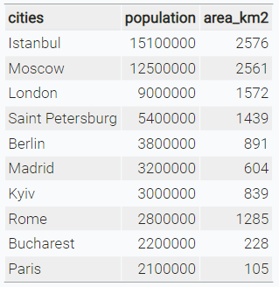
character
numeric

Slide 15





Visualize
R basics
Import
Tidy
Transform
Communicate
Model
Data analysis workflow

Slide 16

Data structure
Import
Tidy
Transform
Visualise

Slide 17
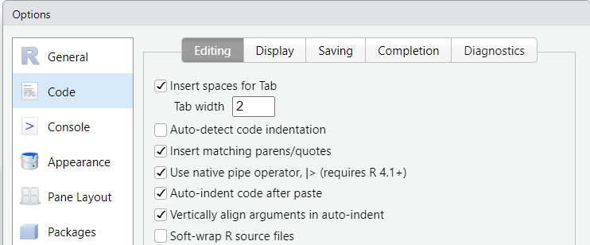

Slide 18
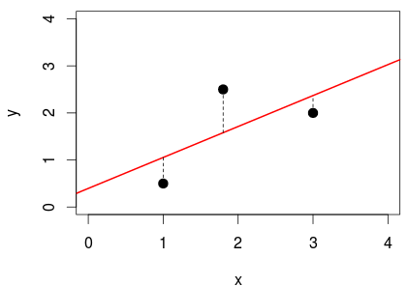

Slide 19
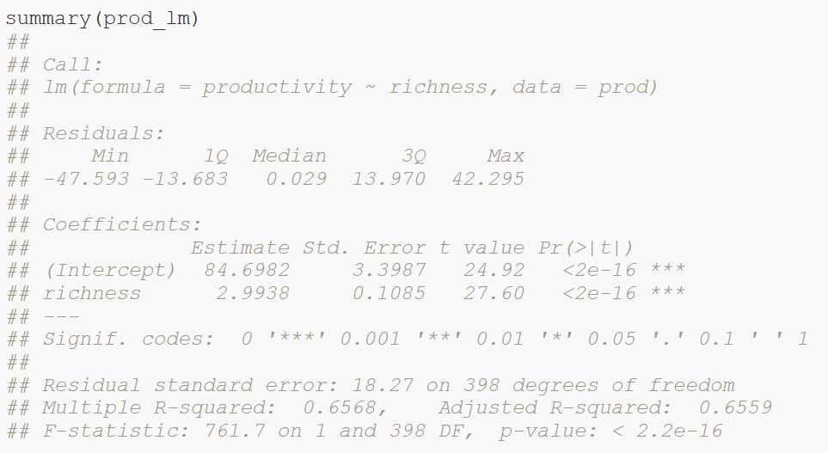
Calculated model
Distribution of residuals (errors)

Slide 20
Model coefficients:
Intercept = 84.7
Slope = 3
Standard error of coefficients

Slide 21
t-statistics: ratio of coefficients to their standard error

Slide 22
Coefficient of determination R²

Slide 23
F statistics: ratio of explained variance compared to null model

Slide 24
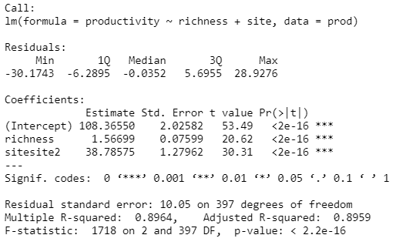
Intercept site1 = 108.4
Slope = 1.6
Intercept site2 = 108.4 + 38.8

Slide 25
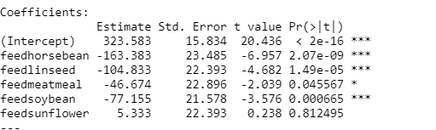
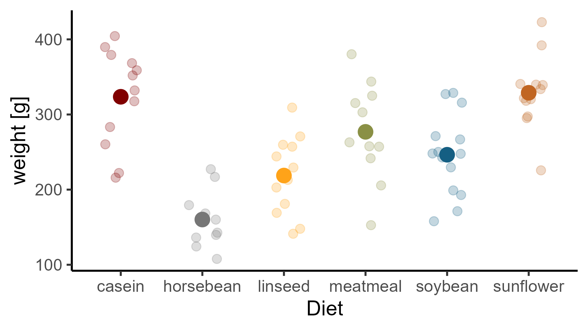

Slide 26
(Intercept) + feedlinseed
(Intercept) + feedsoybean
(Intercept)
(Intercept) + feedsunflower
(Intercept) + feedhorsebean
(Intercept) + feedmeatmeal

Slide 27
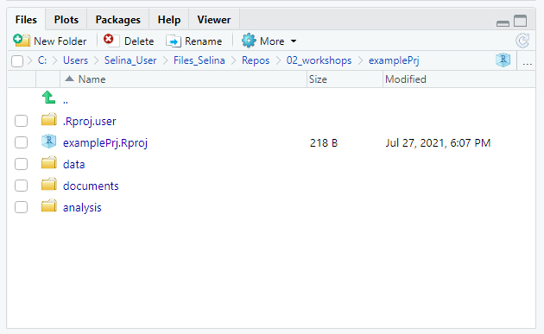
Navigate to project root
Project path
Navigate one level up
Open project in file explorer

Slide 28
Visualize
Import
Tidy
Transform
Communicate
Model
Understand

Slide 29
y
No interaction
y
Interaction
x₁
X₂
a
b
x₁

Slide 30




Slide 31
normal
distribution?
Kolmogorov-Smirnov-test, QQ-test, Shapiro-Wilk-test,..
yes
equal
variance?
F-test
no
yes
no
equal
mean?
t-test
Welch-
test
Wilcoxon-rank- sum-test
Note:
Levine-test not necessary, if you are interested
in equal means, but not equal variances!

Slide 32
Truth
H0 is true
H0 is false
Correct decision
Probability: 1 - α
Type II error
Probability: β
Accept H0
Decision based on statistical test
Type I error
Probability: α
Correct decision
Probability: 1 – β
(Power)
Reject H0

Slide 33


Scientific idea
working hypothesis H1
and
null hypothesis H0
p: how likely would it be to observe the data if the null hypothesis was true?
unlikely (p ≤ α):
reject H0
otherwise: not not reject H0
collect data
chose level of
significance α,
test the null
hypothesis
errors possible

Slide 34
A
B
joined and sorted

Slide 35
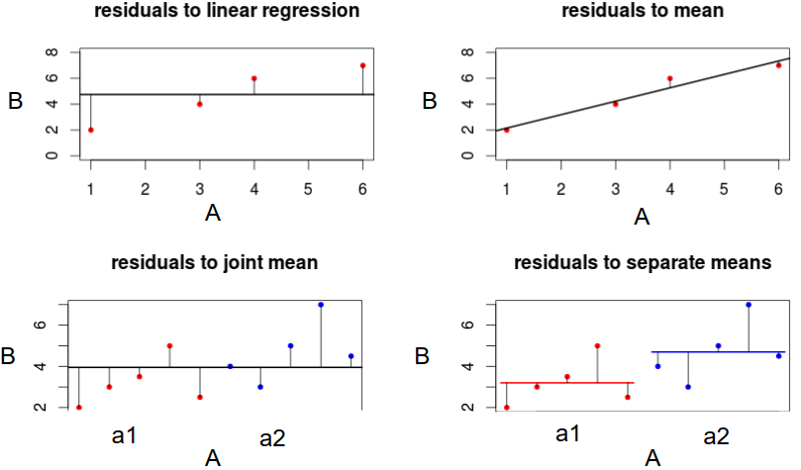
Residuals to mean
Residuals to regression line
Residuals to joint mean
Residuals to separate means

